Slide 1

PYTHON PROGRAMMING SCS1619
Department of Computer Science and Engineering,
School of Computing
SATHYABAMA
Institute of Science and Technology
(Deemed to be University)
Chennai.

Slide 2
UNIT II FILES AND EXCEPTIONS HANDLING , MODULES, PACKAGES

Slide 3
SYLLABUS
File Operations
Iterators
Exception handling
Regular Expressions
Creating Modules
Import Statement
Introduction to PIP
Installing Packages via PIP
Using Python Packages.

Slide 4
File Operations
An object that stores data, settings or programming commands in a computer system is called as a file.
The data’s used in a program is temporary.
The data is lost when the program terminates.
A file is used to store data permanently.
There are three major file operations: 
Opening a file
Performing file operations using Read or Write
Closing the file

Slide 5
File Open
To open a file create a file object and use the open() function.
The open function returns a file object for the filename.
The access mode specifies how the file is used Method: open()
Syntax: File_object=open(filename,Access_mode,buffering)
Attributes:
i. Filename – Name of the file ii.
ii. Access_mode- Mode of Access (Read, Write, Append)
iii. Buffering – 0 (no buffer), 1 (buffer)

Slide 6
File Modes
File Open Mode | Description
w | To write into file, if data is already available in the file, it would be deleted and the present data will be stored.
r | To read data from the file. The file pointer is positioned at the beginning of the file.
a | To append data to the file. Appending means adding at the end of existing data. The file pointer is placed at the end of the file. If the file does not exist, it will create a new file for writing data.
w+ | To write and read data of a file. The previous data in the file will be deleted.
r+ | To write and read data of a file. The previous data in the file will not be deleted. The file pointer is placed at the beginning of the file.
a+ | To append and read data of a existing file, if the file does not existing, it creates a new file for reading and writing
x | To open the file in exclusive creation mode. The file creation fails if the file already exists.

Slide 7
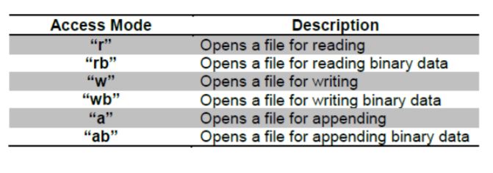
Types of Files
Text File: stores the data in the form of characters.
Binary File : stores entire data in the form of bytes
Example : to open a file

Slide 8
File Reading and Writing
Write(): method is used to write the contents to a file
read() : method is used to read the contents from a file.
readline(): read the particular line of file pointer
Close(): to close the file.

Slide 9
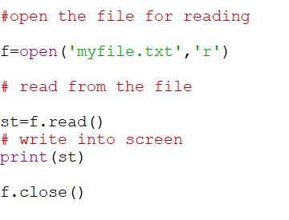
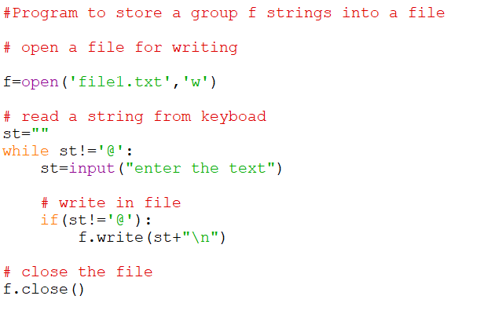
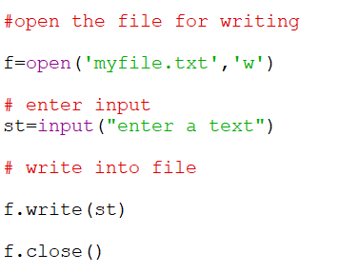
Example

Slide 10
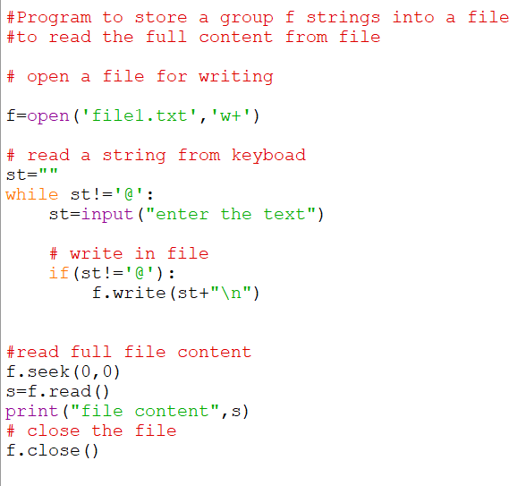
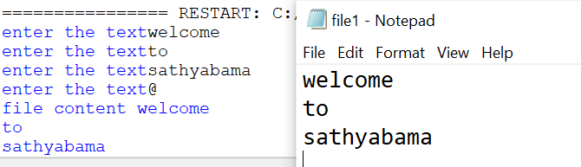

Slide 11
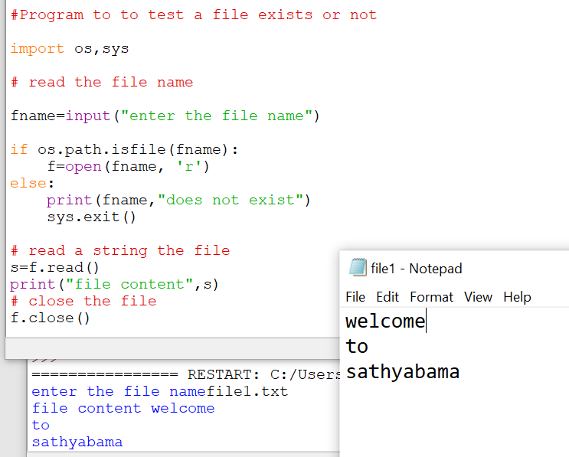

Slide 12
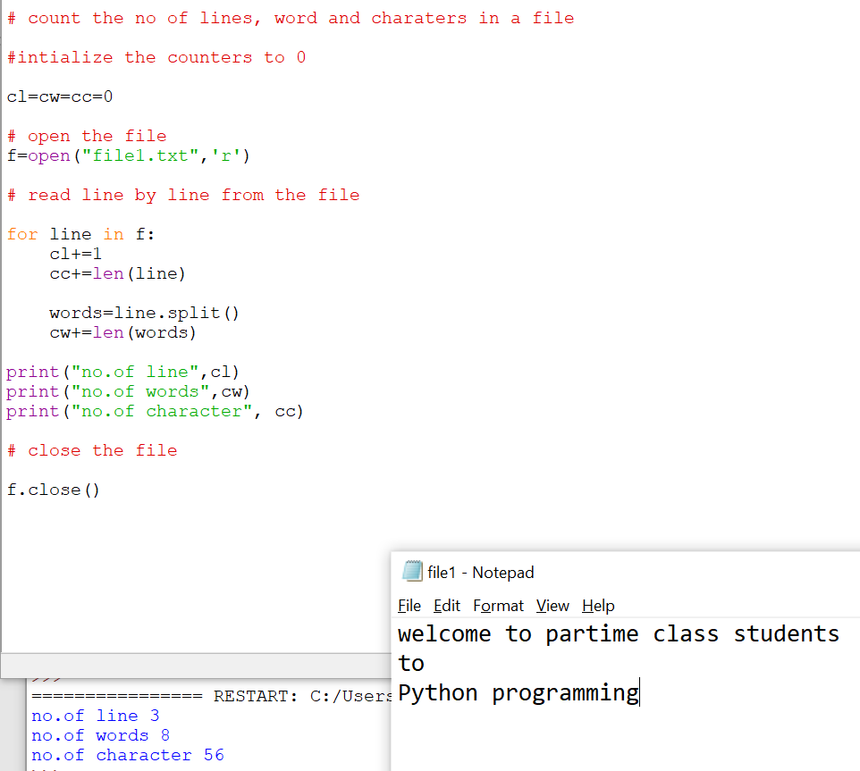
Program to count the no. of lines, Words and Character in a file

Slide 13
with statement
with can be used while opening a file:
Example
with open(‘file.txt’,’w’) as f:
f.write(‘I am a student’)
f.write(‘python program’)
OR
f=open(‘file.txt’,’w’)
f.write(‘I am a student’)
f.write(‘python program’)

Slide 14
File Positions
seek() : to move a file pointer to another position
Syntax: f.seek(offset, from where)
Offset : how many bytes to move
From where : from which position to move , value can be 0 (beginning),1(current) ,2(end).
Example:
f.seek(10) – move fp to 11th byte of the file
f.seek(-10,2) – move file pointer from the end to beginning.
tell(): it returns the current position of the file pointer
example: n=f.tell()

Slide 15
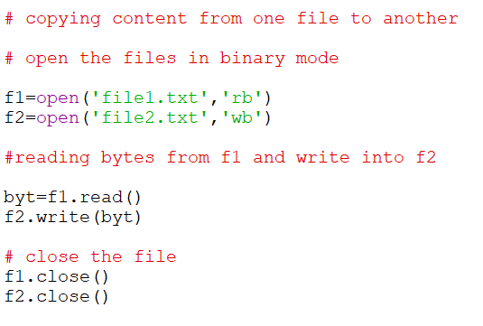
Working with Binary File
Handle data in the form of bytes.
Used to read or write text, images, audio and video files.
Example:

Slide 16
Iterators
An iterator is an object that contains a countable number of values.
An iterator is an object that can be iterated upon, meaning that you can traverse through all the values.
Methods:
__iter__() and __next__()

Slide 17
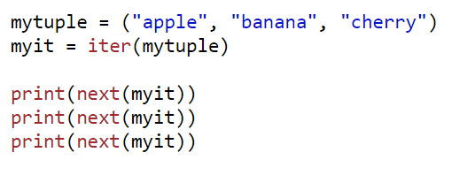
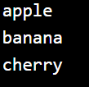
Iterator Vs Iterable
Lists, tuples, dictionaries, and sets are all iterable objects. They are iterable containers which you can get an iterator from.
All these objects have iter() which is used to get an iterator.
Example :

Slide 18
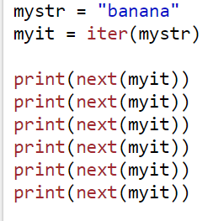

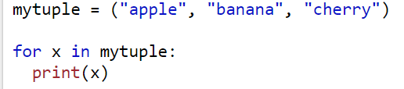
Examples

Slide 19
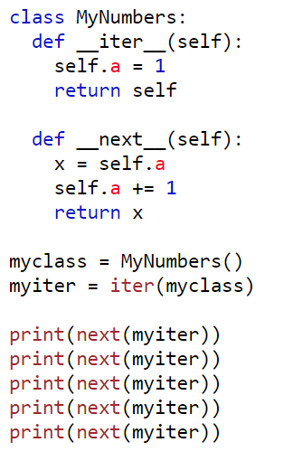

Create an Iterator
To create iterator: need to implement __iter__(), __next()__ and __init()__ methods.
Example: Create an iterator that returns numbers, starting with 1 and each sequence increase by 1

Slide 20
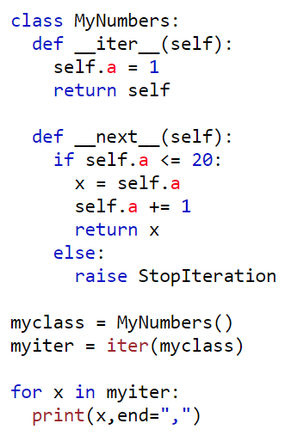
StopIteration Statement
To prevent the iteration to go on forever, we can use the StopIteration statement.
Example:

Slide 21
Regular Expression
It is a string that contains special symbols and characters to find and extract the information needed by us from the given data.
RE help us to :
Search information
Match
Find
Split information
Module used: re
Methods: search(), match(), findall(), split(), compile() etc.

Slide 22
Definition & import statement of RE
Def: Strings containing characters and special symbols.
Ex: r’m\w\w’ r-> raw string
To use Regular Expression:
import re
Operations:
Steps:
Construct the RE
Compile RE
Call the Operation Method

Slide 23
Methods
search() – search the string according to RE and returns the first string.
findall() –returns all matching strings into a list
match() – returns the resultant string only if it is found in the beginning of the string.
split() – splits the string into pieces according to the regular expression and returns the pieces as elements of a list.
sub() – to replace a string with a new string.

Slide 24
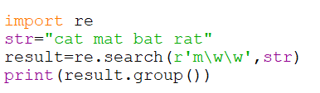

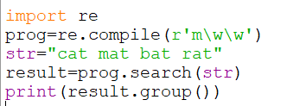
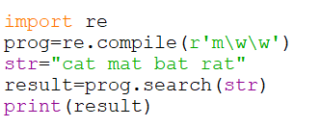
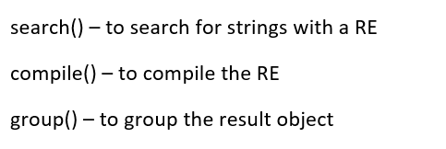
search(), group(), compile()

Slide 25
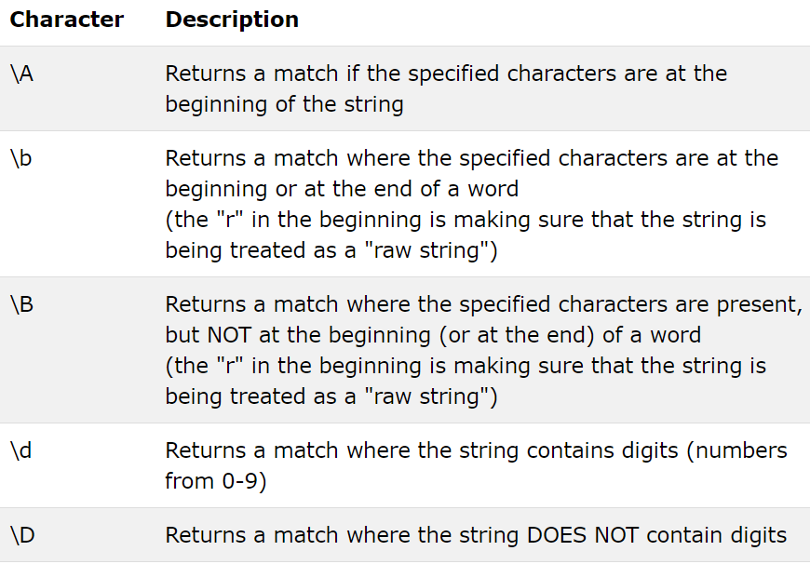
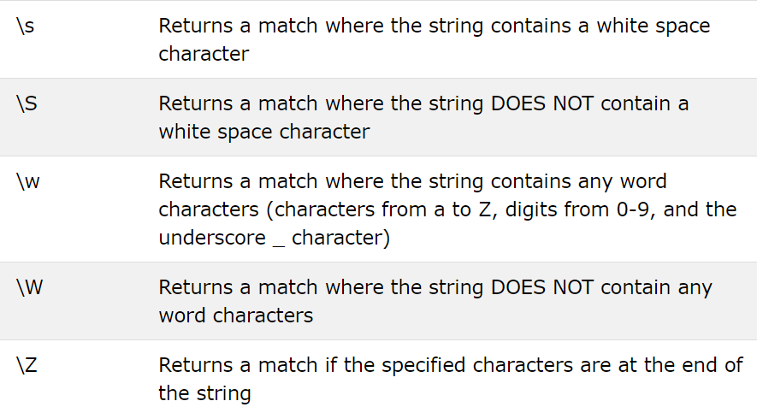
Sequence Characters in RE

Slide 26
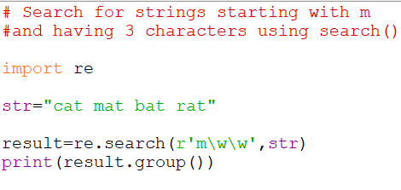
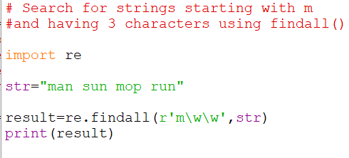

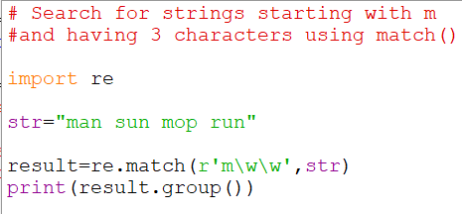
Examples:

Slide 27
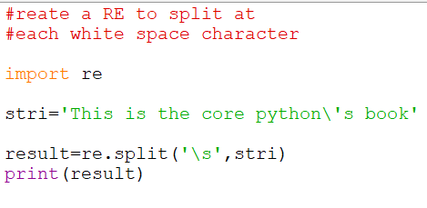
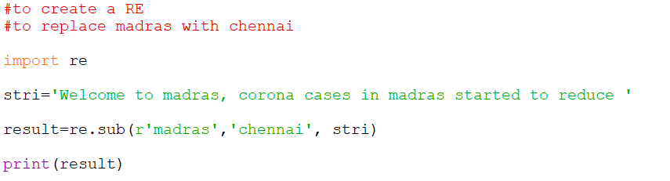

Slide 28
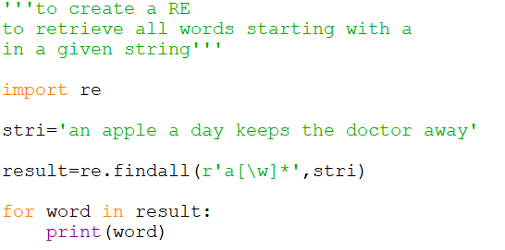

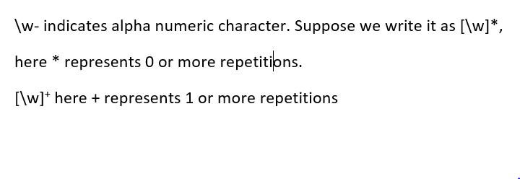

Slide 29
Quantifiers in RE
Character | Description
+ | 1 or more repetitions of the preceding regroup
* | 0 or more repetitions of the preceding regroup
? | 0 or 1 repetitions of the preceding regroup
{m} | Exactly m occurences
{m,n} | From m to n, m defaults to 0, n to infinity

Slide 30
Examples:
To retrieve the ph no. of a person: r’\d+’
To retrieve exactly only name not number from a string: r’\D+’
To find all words starting with an or ak: r’a[nk][\w]*’

Slide 31
Special Characters in RE
Character | Description
\ | Escape special character nature
. | Match any character except newline
^ | Match beginning of a string
$ | Match ending of a string
[….] | Denote a set of possible characters eg: [6b-d] matches any characters 6,b,c,d
[^….] | Matches every character except the one inside the brackets
(….) | Matches the RE inside the () and the result can be captured
R |S | Matches either regex R or regex S

Slide 32
Examples:
Search whether a string starting with He or not:
search(r’^He’,str)
Search whether a string ending with world or not: search( r’world$’,str)
Search whether a string ending with world or not ( ignore case):
search( r’world$’,str, re.ignorecase)
Retrieve marks and names from a string:
findall(r’\d{2},str)
findall(r’[A-Z][a-z]*’,str)
To retrieve the timings am or pm: findall(r’\dam|\dpm’, str)

Slide 33
Exception Handling
Types of Errors:
Compile Time Error
Runtime Error
Logical Error

Slide 34
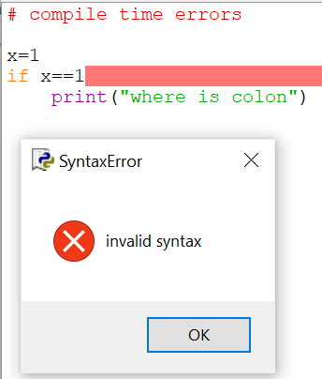
Compiler-Time Error
Errors are detected by the Python compiler

Slide 35
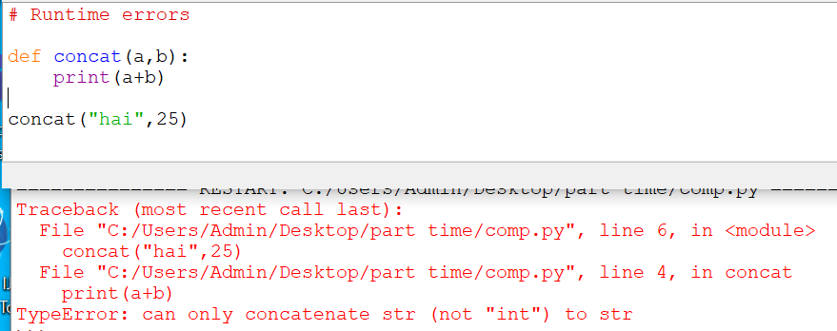
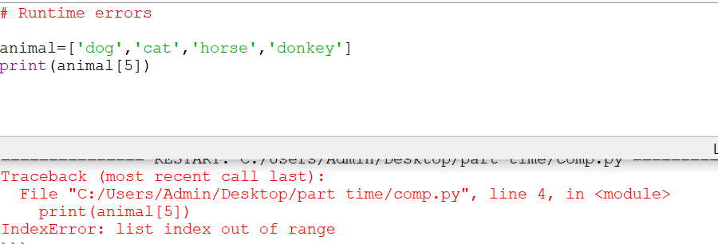
Runtime Errors
The errors detected at runtime by PVM.
Example:

Slide 36
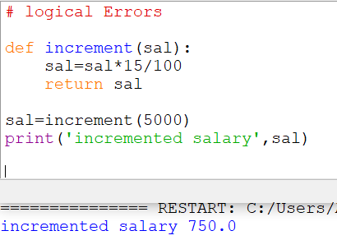
Logical Error
When the design of the program itself wrong.
Salary formula should be :
Sal=sal+ sal*15/100

Slide 37
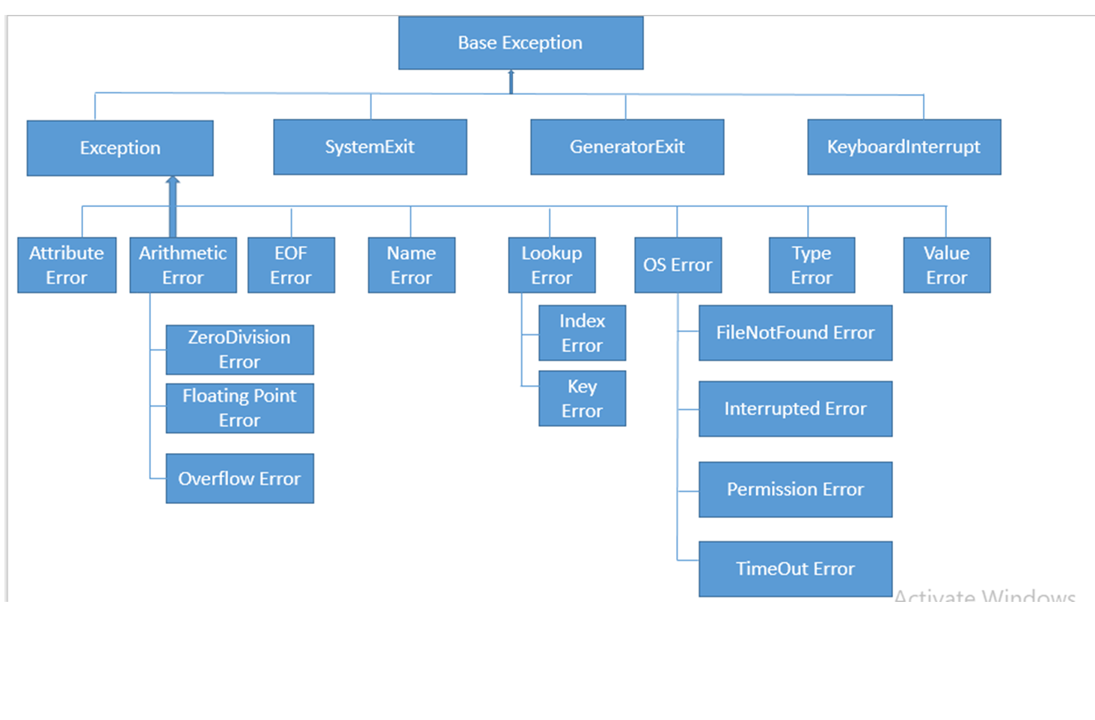
Exceptions
Runtime Errors are known as Exceptions.
Exceptions can be handled by the programmer.
All exceptions are represented as classes.

Slide 38
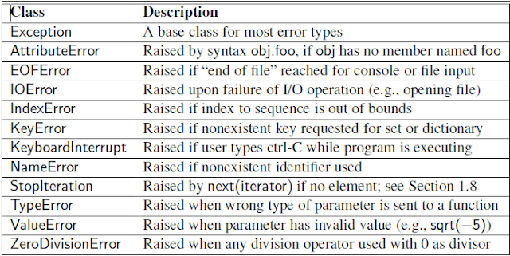
Types of Exception Classes

Slide 39
Exception Handling
Need: to give an appropriate message to the user and continue execution.
Steps:
Step1.Observe the program statements where there may be a possibility of exceptions.
Step 2. To send the error message
Step 3: To receive the error message and take corrective action

Slide 40
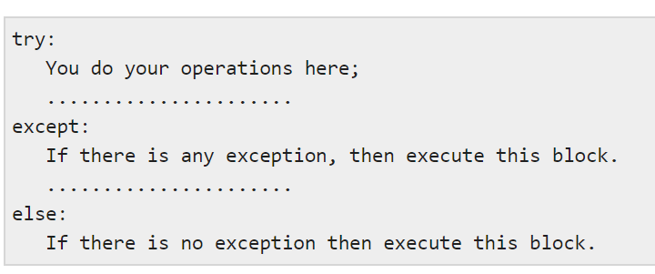
Syntax
Keyword: try, raise, except, finally

Slide 41
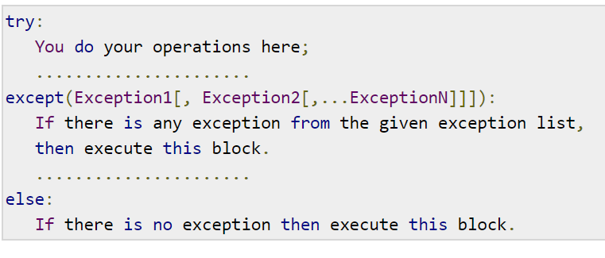
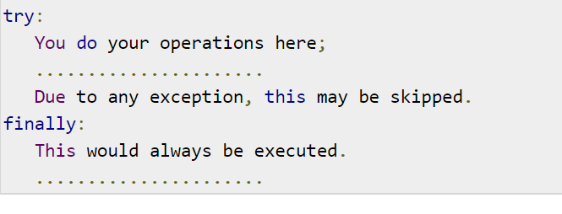
Multiple Exceptions

Slide 42
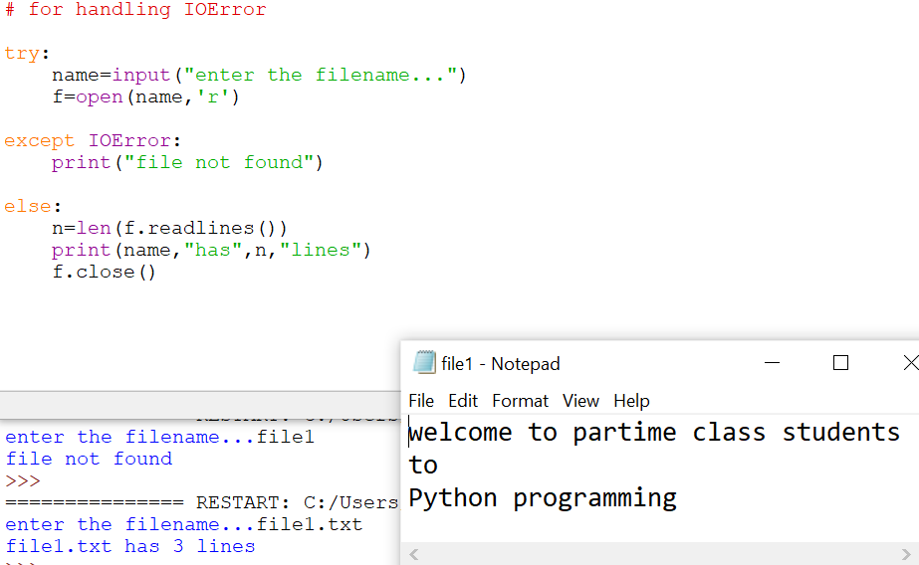
Example

Slide 43
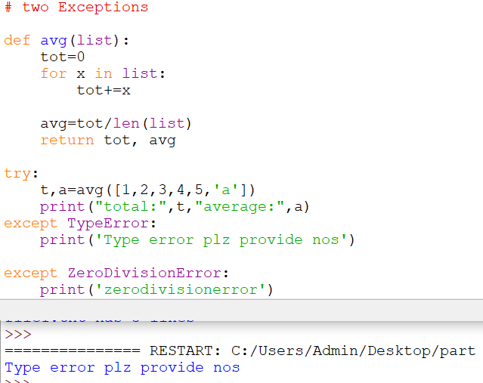
Handling Multiple Exceptions

Slide 44
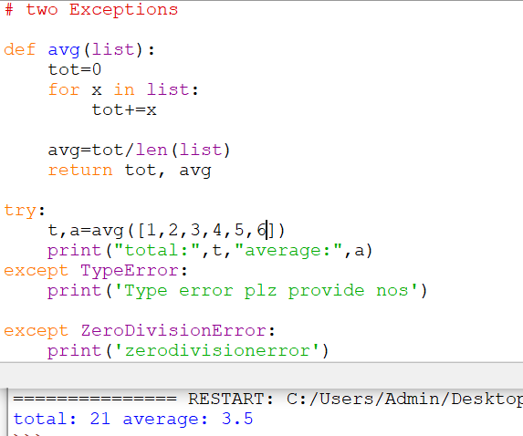

Slide 45
except, finally- keyword
To catch errors that are raised by try block.
Formats of except:
except Exceptionclass:
except Exceptionclass as obj:
except(Exceptionclass1, Exceptionclass2……):
except:
Format of Finally:
finally:

Slide 46
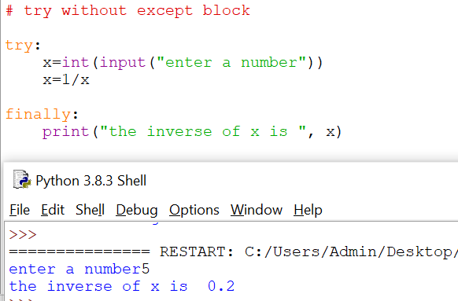
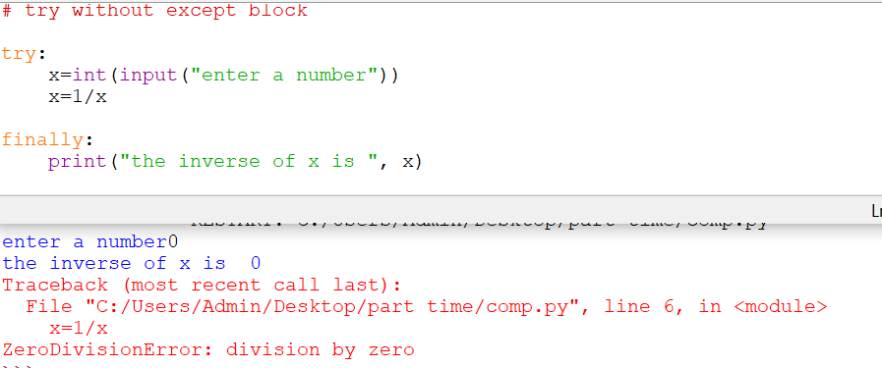
Example

Slide 47
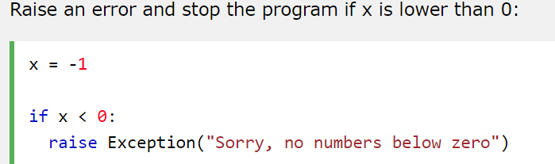
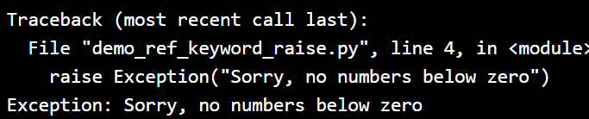
raise- keyword
To send error messages and stop the program
Format:
raise Exception class()
Example:

Slide 48
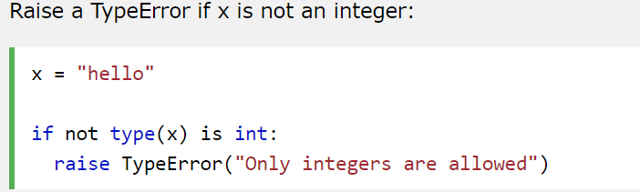
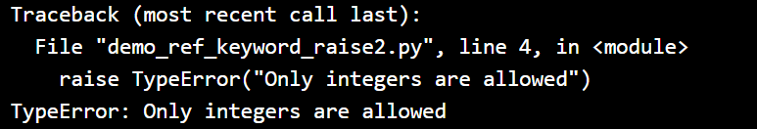

Slide 49
User Defined Exceptions
Step1: Create a sub class with the base class Exception.
Step2: inside the class have a constructor to initialize the object.
Step 3: if exception comes , need to be raised using raise keyword.

Slide 50
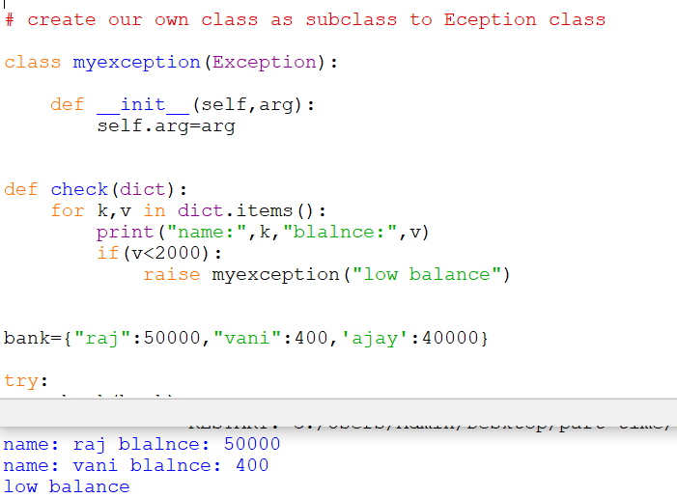

Slide 51
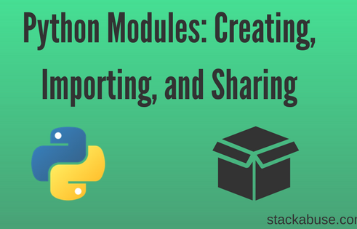

Slide 52
Creating Modules
Modules refer to a file containing Python statements and definitions.
Use modules to break down large programs into small manageable and organized files.
Modules provide reusability of code.
Define our most used functions in a module and import it, instead of copying their definitions into different programs.

Slide 53
Types of Modules
Built in Modules
Example:
os
sys
math
statistics
Collection
random
User defined Modules

Slide 54
Importing Modules
Import the definitions inside a module to another module or the interactive interpreter in Python.
Use: import keyword
Formats of import statement:
# import with module name – module name is used to access the module member.
import example
# import with Rename – rename is used to access the module member.
import example as ex
#Python from...import statement
from example import add
from example import* #import all names

Slide 55
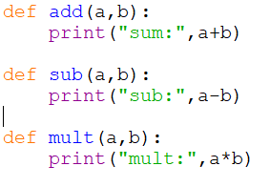


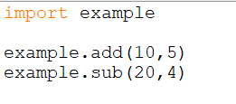




Slide 56

Example

Slide 57
Introduction to PIP
PIP is a package manager for Python packages, or modules.
What is a Package?
A package contains all the files you need for a module.
Modules are Python code libraries you can include in your project.

Slide 58

Using Python Packages
A module can contain multiple objects, such as classes, functions, etc.
A package can contain one or more relevant modules.
Physically, a package is a folder containing one or more module files.

Slide 59
Package
Let's create a package named mypackage, using the following steps:
Create a subfolder with the name 'mypackage'.
Create an empty __init__.py file in the mypackage folder.
Using a Python-aware editor like IDLE, create modules.

Slide 60




Example
mypack
Use Package
OUTPUT

